Slide 1
Metabolic Diseases Lesson 4.1
What is nutrition science?

Slide 2
Do Now
What scientific questions do you have?
How do these questions get answered?

Slide 3
Scientists use the scientific method
Ex. People that are obese are more likely to have Type 2 Diabetes than people that are thin
Ex. Do an experiment that compares how fatty acids interact with insulin receptors in thin and obese people
Ex. Need to know what Type 2 Diabetes is and what defines obesity
Ex. Fatty acids leaking out of the adipose cells in obese people may cause the insulin receptors to not function

Slide 4
Is science a collection of facts? (2:39-9:04)
Notes:
6:43 minutes

Slide 5
Knowing some facts makes it easier to ask good questions
Questioning comes into play in 2 steps:
When we do background research we have to filter questions – addressed vs. not addressed.
Hypothesis question is one that no one know the answer to

Slide 6
Activity: Asking Questions
Unknown to me: Qs you have and someone knows the answer.
Unknown to everyone: Qs you have but nobody knows the answer.
Errors: Qs that result from misconceptions
Taboos: Qs that you are too afraid to ask
Denials: Qs you refuse to ask
Unknown unknowns: The Qs of tomorrow that you don’t even know you’re going to ask!
Adapted from Dr. Witte et. al.; www.ignorance.medicine.arizona.edu
Notes:
Discuss where science research falls (known unknowns). What types of questions would fall into each of these categories? Have students try to come up with questions they have about what we have seen so far in the MD module and map them to this image. Students likely won’t be able to differentiate between ‘unknown to me’, ‘unknown to everyone’, and ‘errors’. On the WS the categories ‘denials’ and ‘unknown unknowns’ have been removed, because these are questions that either we won’t ask or questions we don’t know we have!
Relate this to the scientific method: Unknown to me is background research, Unknown to everyone is a scientific question.

Slide 7
How do scientists answer their questions about nutrition?
What are the types of studies?
Interventional
Compare a treatment and a control group.
Observational
Compare groups.
Measure something over time

Slide 8
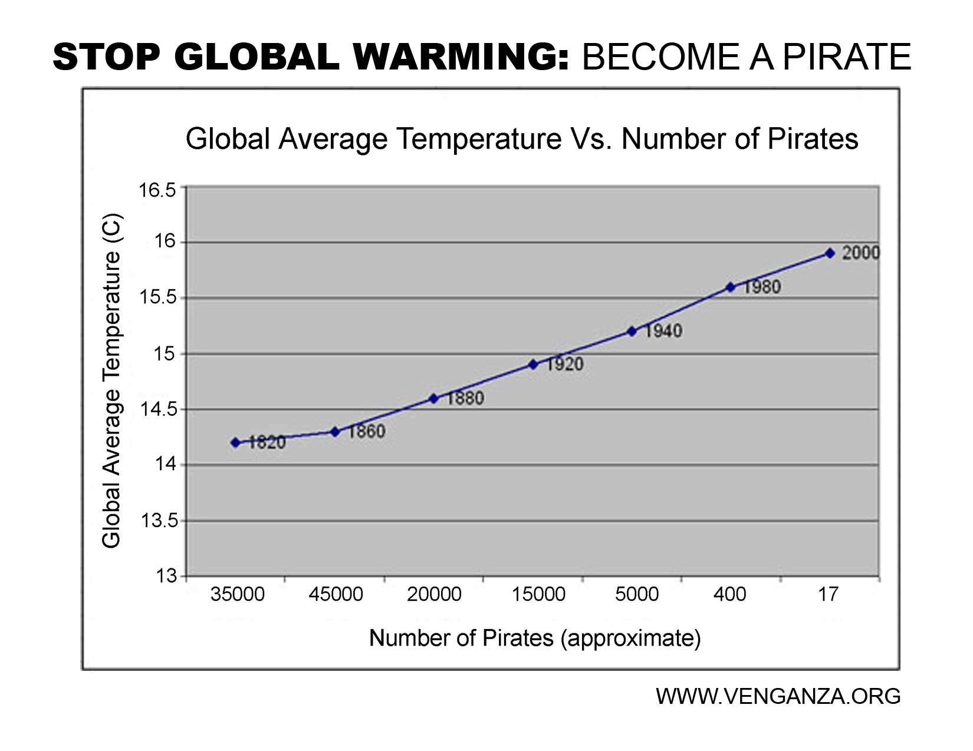
What is the difference between correlation and causation when it comes to study results?
Observational studies can’t distinguish between correlation and causation.
Only shows correlation
Interventional studies can show causation.
Results often get misinterpreted because of the confusion between correlation and causation

Slide 9
Study Types
Meta-Analysis
Randomized Controlled Trials
Observational Studies
Animal Studies
In Vitro (Cell Culture) Studies

Slide 10
Wrap Up
Science is the study of the unknown, but we have to know some facts to ask good questions.
How do you recognize a good scientific question?

Slide 11
Homework
Complete the Lesson 4.1 Homework Worksheet

